Slide 1


Comptroller’s Guide to
NON-PROFIT
FISCAL MANAGEMENT

Slide 2

What We Will Cover Today
Know Your Contract
The Advance Process
The Claim Process Overview
Preparing a Claim
Claim’s Checklist

Slide 3

What We Will Cover Today
How Many of You Submit Perfect Claims?
4 in 5 claims are submitted NOGO
This Photo by Unknown Author is licensed under CC BY-NC-ND

Slide 4

What We Will Cover Today
Why doesn't Comptroller’s fix the Claim themselves,
its just missing a …. ?
Auditors only have 2 options
This Photo by Unknown Author is licensed under CC BY-NC-ND

Slide 5
What We Will Cover Today
Vendor Claims is Audited too…
Audit & Control | NC External Auditor, Comptroller’s Field Audit Division
Program Oversight | US Gov (HHS), NYS Gov (NY OA, OASIS, State Comptroller), Other County Departments
Law Enforcement/Legal | County DA, IG & NCPD; State AG; Federal Agencies; Public FOILS

Slide 6
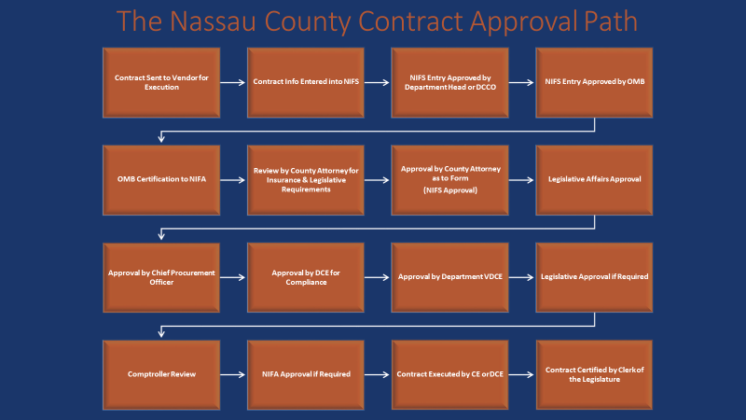
1. Know Your Contract

Slide 7
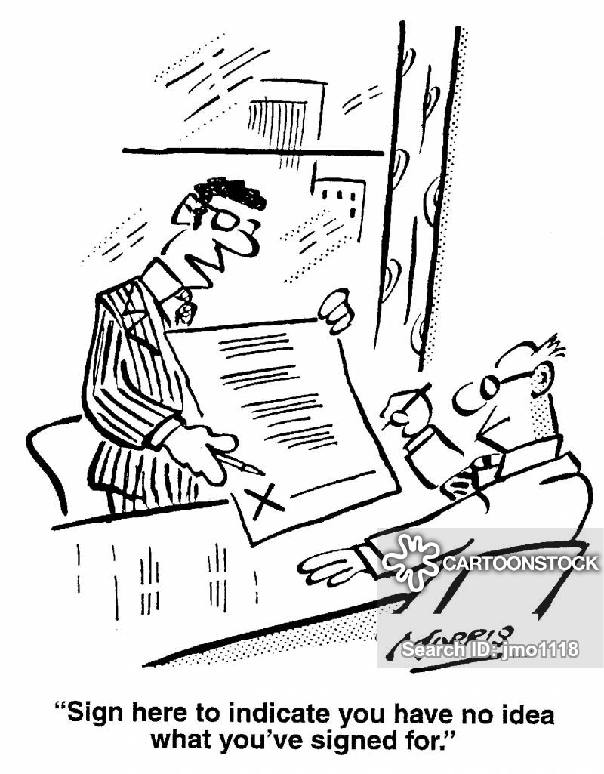
1. Know Your Contract
Auditors match claims to specific provisions in the contract.
If it is not in the contract, auditors are not able to approve (no authority).

Slide 8
1. Know Your Contract
TERM:
  “This agreement shall commence on January 1, 20xx and terminate on December 31, 20xx, unless sooner terminated in accordance with the provisions of the agreement.” Emphasis Added.

Slide 9
1. Know Your Contract (cont.)
SERVICES:
  “. . . The program which is more fully described in Appendix A attached hereto and incorporated herein by reference shall be subject to the direction, approval and control of the Office.”

Slide 10
1. Know Your Contract (cont.)
PAYMENT:
  “Amount of Consideration. The maximum amount to be paid to the Contractor as full consideration for the Contractor’s services under this Agreement (the “Maximum Amount”) shall not exceed xxx,xxx and 00/100 dollars, payable as follows:”

Slide 11
1. Know Your Contract (cont.)
ACCOUNTING PROCEDURES; RECORDS.
  A) “Records shall be maintained in accordance with GAAP and, if the Contractor is a non-profit entity, must comply with the accounting guidelines set forth in the Federal Office of Management and Budget 2. C.F.R. Part 200.” Such records shall at all times be available for audit, inspection and copying by the Comptroller . . .”
  EVERY CLAIM SHOULD BE PREPARED WITH FULL SUPPORTING DOCUMENTATION, EVEN IF NOT REQUESTED BY DEPT. OR COMPTROLLER.

Slide 12
1. Know Your Contract (cont.)
ACCOUNTING PROCEDURES; RECORDS.
  FEDERAL:
    2 Code of Federal Regs. Part 200 (Cir. A-122)
  STATE:
    Consolidated Fiscal Reporting and Claiming Manual
    NYS Comptroller’s Local Gov. Mgmt. Guides
    NYS Program Specific Guides (i.e. OASAS, OFS, etc.)
  COUNTY:
    Guide for preparation of Youth Board Vouchers
    Mental Health, Chemical Dependency Claim Guides

Slide 13

1. Know Your Contract (cont.)
ACCOUNTING PROCEDURES; RECORDS. (Full Documentation)
  Federal guidelines require vendors to maintain full supporting documentation “readily available” for each claimed expense.
  This info must be on file/available to both the Department and Comptroller’s, upon request.
  Vendor may elect to submit full documentation with every claim.
  Full Documentation is the rule, not the exception.
This Photo by Unknown Author is licensed under CC BY-NC-ND

Slide 14

1. Know Your Contract (cont.)
ACCOUNTING PROCEDURES; RECORDS.
  Funds should be in segregated bank accounts.
  Do Not COMMINGLE funds from multiple programs and/or contracts.
  Each contract’s funds should be easily identifiable on bank statements from receipt to expense.
National Council of NonProfits Industry Best Practice Guides:
https://www.councilofnonprofits.org/tools-resources-categories/financial-management
This Photo by Unknown Author is licensed under CC BY-NC

Slide 15
1. Know Your Contract (cont.)
ACCOUNTING PROCEDURES; RECORDS.
  B) Within x days of the termination of this Agreement, Contractor shall file with the Office and the Comptroller of the County, reports as follows:
      A complete and verified reconciliation report to include all monies received and monies expended during the term of this Agreement, must be submitted with the final claim voucher.
      A Final Project Report (to department)
      Annual Inventory Certification (to department)
  Does the contract require reports, etc.? If so, department must submit written confirmation it was received or satisfactory (see contract for specifics).

Slide 16
1. Know Your Contract (cont.)
MODIFICATIONS TO CONTRACT BUDGET (If Applicable).
  Vendor may make adjustments to Universal Budget if less than 10%.
  Vendor may make adjustments to Universal Budget if more than 10%, with Departmental Approval.
  TOTAL does not change, only category amounts

Slide 17
2. The Advance Process
PAYMENT PROVISION:
  “one third (1/3) of the amount above shall be paid in advance upon the final execution of the Agreement; and”
  Subsequent payments shall be on a reimbursement basis for actual expenses incurred and solely in accordance with the budget attached hereto.”

Slide 18


2. The Advance Process (cont.)
Advances are generally approved by the Claims Division on the same day, so long as the following are in our possession: (1) Prior Contract is Reconciled, (2) Certified Contract and (3) Completed Claim Voucher.
This Photo by Unknown Author is licensed under CC BY
This Photo by Unknown Author is licensed under CC BY-NC-ND

Slide 19
2. The Advance Process (cont.)
1
Reconcile Prior Year Contract
2
Current year contract executed AND a certified copy delivered to Comptroller’s Office
3
Submit completed voucher to Dept. for Comptroller Claims approval

Slide 20
2. The Advance Process (cont.)
If CO approves by End of Day Monday, TR will make Payment on Wednesday.
If CO approves by End of Day Wednesday, TR will make Payment Friday.
*Schedule is subject to change at the discretion of the Nassau County Treasurer.

Slide 21
3. Claim Process Overview
1. Department (authorization)
Level 1: Claim is assembled and certified by department recommending payment.
Level 2: Claim Receives Supervisory Review prior to submission to Comptroller’s for Audit.
2. Comptroller Claims (audit & approval)
Level 1: Claim is audited by dedicated non-profit team, and, if documentation is satisfactory, approved.
Level 2: If claim is over $100k, it requires audit by a supervisor prior to final approval.
3. Treasurer’s (payment)
Approval received electronically by Treasurer’s Department, either prior to close of business on Monday or Wednesday.
For all claims approved prior to close of business on Monday, payment is made Wednesday, for Wednesday, payment made on Friday.

Slide 22


3. Claim Process Overview
Auditing Asst. IV
Auditing Asst. II (flex)
Auditing Asst. III
Auditing Asst. II
Auditing Asst. II
Vendor Claims
Non-Profit Team

Slide 23
3. Claim Process Overview
What happens to my claim when I send it to Comptroller’s?
Originating
Department
Comptroller
Vendor Claims
Fiscal Officer
Comptroller
Deputy Review
(if needed)
Treasurer’s Department
Vendor Receives Payment
Comptroller
Vendor Claims
Auditor
Comptroller
Vendor Claims
Supervisor
Vendor submits Claim

Slide 24
3. Claim Process Overview (cont.)
How long does the process take (IGO)?
  After the Department submits to CO, a claim is generally approved within less than 30 days, if In Good Order (IGO).
How long does the process take (NoGo)?
  If NOt in Good Order, each email back and forth may delay claims as much as a few days. Each official rejection may delay claims as much as an additional week or longer.
On average, 4 in 5 claims contain at least one error and require more information.

Slide 25
4. Preparing a Claim
BASICS
  Section 2, Contract
  Sections 4-7, Vendor Info.
  Section 8, Vendor Cert.
  Section 11, Details
  Section 12, Claim Total
  NC Dept. Certification

Slide 26

4. Preparing a Claim
GENERAL AUDIT STANDARDS.
  Any and all guidelines specified in contract (see previous slides).
  Office of the State Comptroller’s Division of Local Government and School Accountability, Local Government Management Guide for Improving the Effectiveness of Your Claims Auditing Process

Slide 27
4. Preparing a Claim
GENERAL AUDIT STANDARDS (cont.)
  Industry Standards & Best Practices:
    National Council of Nonprofits: https://www.councilofnonprofits.org/
    New York Council of Nonprofits: http://www.nycon.org/
    Nonprofit New York: https://www.nonprofitnewyork.org/

Slide 28
4. Preparing a Claim (cont.)
PROOF OF PAYMENT.
  All charges require “Proof of payment,” clearly showing amount being paid, and consists of, but is not limited to:
    canceled checks,
    bank statements,
    notice of electronic payment, or
    confirmation email of electronic payment or automatic payment made, etc.
    When using Credit cards, proof of payment is a credit card statement with amount indicated AND proof of how the credit card was paid.

Slide 29
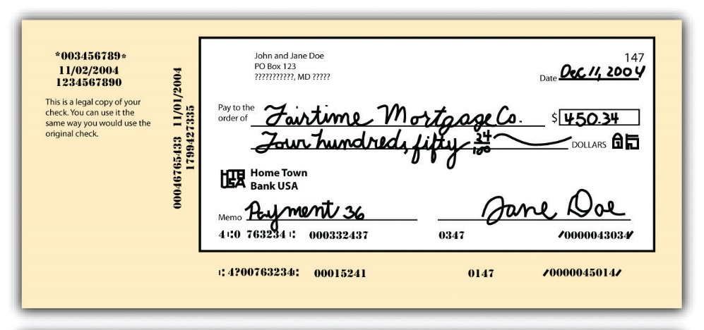
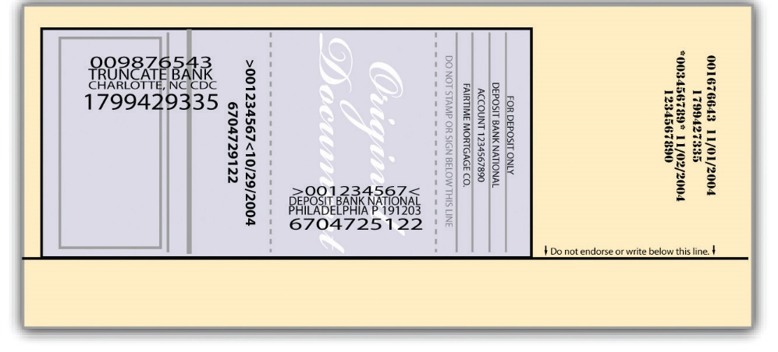
4. Preparing a Claim (cont.)
PROOF OF PAYMENT (cont.)
Cancelled Check
Bank Statement
This Photo by Unknown Author is licensed under CC BY-SA-NC

Slide 30
4. Preparing a Claim (cont.)
UNIVERSAL
BUDGET

Slide 31
4. Preparing a Claim (cont.)
1a. SALARY/PAYROLL
“Certified” payroll, either
  Reports from a data processing or payroll company for period claimed with name/title, check #’s, proof of payment (if not ACH), payroll period, gross amount of pay and allocation should be indicated.
  In the case of vendors that do not use a payroll company, please provide copies of cancelled checks or bank statements indicating check numbers or automatic payments.
If employee is hourly or PT, a timesheet is required
Titles need to be accurate.

Slide 32
4. Preparing a Claim (cont.)
1a. SALARY/PAYROLL
Certified Payroll Register From Payroll Company
OR Supervisor Report AND cancelled check
Earning’s Statement

Slide 33

4. Preparing a Claim (cont.)
1b. FRINGE
Complete invoices, including list of names claimed and calculation of allocations.
Individuals listed in FRINGE must match individuals claimed in payroll.
Payroll
Fringe
This Photo by Unknown Author is licensed under CC BY-NC-ND

Slide 34
4. Preparing a Claim (cont.)
1b. FRINGE
Benefits Invoice
Reconciliation Report

Slide 35
4. Preparing a Claim (cont.)
2. CONSULTANTS
Submit contract agreements, time sheets and/or invoices for independent contractors or consultants, invoices for contractual services.
In certain instances, less or more documentation may be required, depending on the situation.
  In general, Consultant/Contractual agreements are required for those that have them (i.e. professionals – includes hours to be worked and rate of pay).
  Invoices could be accepted for those like repair, exterminators, etc (outside services that do not have specific agreements, etc.).

Slide 36
4. Preparing a Claim (cont.)
3. TRAVEL/PER DIEM/TRANSPORTATION
A log for mileage claimed, receipts for gas, tolls, transit, parking, metro cards, etc. claimed, receipts for any travel related to conferences/training.
Verify whether written Departmental approval is required for any claims for out-of-state travel, and if so, please provide.
“First Class” markup is not a reimbursable expense.
Is person attending event also on payroll for that period?
For more information, you may reference the Office of the New York State Comptroller’s Local Government Management Guide for Travel and Conference Expense Management.

Slide 37
4. Preparing a Claim (cont.)
3. TRAVEL/PER DIEM/TRANSPORTATION
<- Ticket Invoice
Travel Mileage Log

Slide 38
4. Preparing a Claim (cont.)
4. EQUIPMENT
Prior written department approval should be submitted for purchase caps and three (3) bids, if applicable.
The bids should be submitted to the Department as supporting documentation with the voucher where the purchase is being claimed. If the lowest bid was not used, then a statement explaining why the winning bidder was used is required.
In all cases the lowest responsible bidder is awarded the order/contract, if not, provide explanation.
Remember, equipment is property of the State or County (depending on program) and must be inventoried.

Slide 39
4. Preparing a Claim (cont.)
4. EQUIPMENT (Cont.)
Purchases are subject to NY State General Municipal Law and Nassau County Procurement Policy, which include the following (if vendor has its own procurement policy, it must be provided):
Purchases under $500 do not require competitive bids. Only one recorded quote is required. Additional quotes may be requested if the Buyer deems it appropriate for savings potential.
Purchases $500 to $2999 require three informal competitive bids. The Buyer must obtain and record at least three verbal quotations.
Purchases $3000 to $9999 - The Buyer must obtain and record at least three written informal quotations from the vendors.
Purchases $10,000 or more - The Buyer must prepare a Formal Sealed Bid which has a separate set of compliance rules requiring strict adherence. The sealed bid is typically sent to at least three bidders and is advertised in Newsday. Bid notification is also posted on the Nassau County website www.nassaucountyny.gov, “eServices for Business”, “Bid Solicitation Board
Vendors are given a minimum of 5 days to respond, although most formal bids provide additional time. Sealed bids are opened publicly at a precise, prescribed time and location. Other minor procedural requirements may apply.

Slide 40
4. Preparing a Claim (cont.)
4. EQUIPMENT (Cont.)
Vendor
Item type
Serial #
Cost
Period
Since <$2,999
+ 2 more bids
+Proof of Payment

Slide 41
4. Preparing a Claim (cont.)
5. SUPPLIES
All supplies must be supported by documentation (clearly visible receipts that also show date, store, amount).
  In all cases, a receipt or proof of purchase is required.
  In instances where the purpose of the supply is not immediately recognizable, please provide a letter stating the purpose of the purchase.
    i.e. “A truckload of sand,” or “Clown Costume”

Slide 42
4. Preparing a Claim (cont.)
5. SUPPLIES

Slide 43
4. Preparing a Claim (cont.)
6. CONTRACTUAL SERVICES
Contracts for service agreements and rental agreements, or invoices for consultants and/or contractual services.
This must include rate and hours.
If purpose of contractual service is not immediately identifiable as being program specific, provide explanation.

Slide 44
4. Preparing a Claim (cont.)
6. CONTRACTUAL SERVICES
Contractor Name
Compensation
Services Rendered
Signed by parties

Slide 45
4. Preparing a Claim (cont.)
7a. RENT
Provide invoice from landlord and current lease/rider (or you may get one or the other).
Also, provide itemized bill from landlord for each category when rent includes utilities and taxes.
If organization owns its facility and has a mortgage, “Mortgage Interest” must be included in this category.

Slide 46
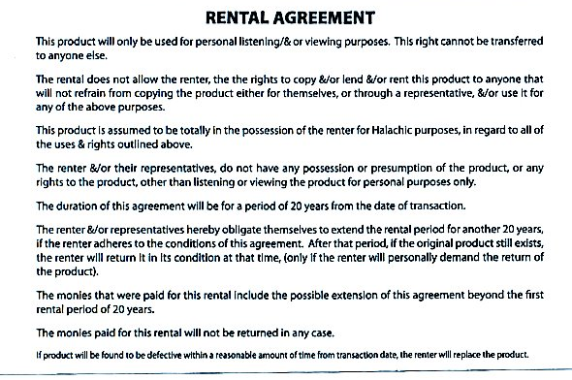



4. Preparing a Claim (cont.)
7a. RENT (cont.)
Mickey Mouse
LLC
+ Proof of Pmt.
This Photo by Unknown Author is licensed under CC BY-SA
This Photo by Unknown Author is licensed under CC BY-NC-ND

Slide 47
4. Preparing a Claim (cont.)
7b. UTILITIES
For Gas, Electric, water, heating oil, phone, cable and communications, claims require complete current invoices dated within the contract period.
  Late fees not allowed
  No “Past Due” amounts
  If location is uncommon, please explain (i.e. offsite facility, temporary space, etc.).
  Are January claims pro rated for December?

Slide 48
4. Preparing a Claim (cont.)
8. DEPARTMENT SPECIFIC
In the event you are instructed to make a purchase by the Department:
  Complete current invoices dated within contract period
  Include departmental instructions

Slide 49
4. Preparing a Claim (cont.)
9. OTHER
Conferences/Training
  Agendas, confirmation of registration and proof of attendance is always required for claims.
    Proof of Attendance can be as simple as a list of employees attending, if it’s local. It could be a hotel bill, conference registration, certificate of completion and/or agenda for an out of town conference. More or less documentation may be requested depending on the specific documentation provided.
    In the event no Proof of Attendance is available, a signed certification will be required.

Slide 50
4. Preparing a Claim (cont.)
9. OTHER
Conference Invoice (include proof of payment) (A)
Proof of Attendance (B)
Conference Program (C)
A
C
B

Slide 51
4. Preparing a Claim (cont.)
10. ADMIN OVERHEAD
Usually a fixed percentage for program management costs (i.e. 10%).
  Must show calculation (i.e. $100,000 (total) x 10% (admin fee)= $10,000.)

Slide 52
4. Preparing a Claim (cont.)
NON-ALLOWABLE CHARGES
  NYS Consolidated Fiscal Reporting and Claiming Manual, Appendix X: Adjustments to Reported Costs
    Sales Tax
    Late fees,
    Contributions/Donations,
    Fines, costs related to failure to comply with Fed, State or Local laws (i.e. tickets, fines)
    Among many others . . .

Slide 53
4. Preparing a Claim (cont.)
Introduction of eClaims application, starting July 1, 2020.
  Creates data warehouse with access for vendors, department and Comptroller’s.
  LIVE view of where a claim is in approval process.
  Ability for vendors to see and respond to issues as they occur.
  One consolidated record of all information pertaining to a specific claim.

Slide 54

5. Claim’s Check List
Did you receive and provide WRITTEN Departmental/State approval where necessary?
Did you Organize? Submit the claim in orderly fashion, with supporting documentation following sequence of universal budget itemization and summary sheets.
Did you remove past due amounts on invoices/bills?
Did you explain any calculations?
Are copies legible and neat? If is difficult for you to read, it will also be for us.
Do invoices/claim voucher back-up name the service/item being purchased, not just the Credit Card Company or Bank?
Are costs clearly related to the program? If not, explain (i.e. clowns, truck of sand, etc.).
Did you sign you certify the claim?

Slide 55
More Information
Gabriel S. Marques, Esq.
Fiscal Officer
Claims Division
240 Old Country Road
Mineola, NY 11501
Direct: (516) 571-1756
gmarques@nassaucountyny.gov
Version 2, June 2019

