Slide 1



Nassau County Office of Community Development
FY 2025 Fair Housing Forum
April 15, 2025 – 11:00 AM
Presenters
Irene Villacci, Esq. – Deputy County Attorney, Office of the Nassau County Attorney
Gina Martini, AICP – Planning Consultant, VHB
Ian Wilder, Esq. – Executive Director, Long Island Housing Services
Rodney H. McRae – Executive Director, Nassau County Human Rights Commission
Maria Rivera – Human Rights Investigator, Nassau County Human Rights Commission
Kate Drossos – Human Rights Investigator, Nassau County Human Rights Commission
Bruce A. Blakeman
Nassau County Executive
Jeffrey M. Clark
Executive Director of Community Development

Slide 2
Agenda
Key Objectives
Fair Housing in Nassau County
Fair Housing Act
  Overview
  Additional Protections
  Fair Housing and Accessibility
Enforcement
  Fair Housing Complaint Process
Community Outreach and Participation

Slide 3
Key Objectives

Slide 4
Key Objectives of Today’s Fair Housing Forum
Fair Housing in Nassau County
Explore the local context and significance of fair housing practices.
The Fair Housing Act (FHA)
Understand the purpose of the FHA in the United States.
Protected Classes and Additional Protections in New York and Nassau County
Learn about federally recognized protected classes and unique local protections.
Unlawful Practices under the Fair Housing Act
Identify what constitutes discrimination and illegal practices under the FHA.
Disability and Accessibility under the FHA
Examine rights and provisions related to disability and accessibility.
Fair Housing Complaints and Process in Nassau County
Discover how to file complaints and navigate the fair housing process locally.

Slide 5
Fair Housing in Nassau County

Slide 6
Fair Vs. Affordable Housing
Affordable Housing becomes a Fair Housing issue when it is shown that a lack of Affordable Housing is preventing integration – or that the concentration of Affordable Housing is encouraging segregation.
When protected classes are shown to be disparately impacted by the lack/concentration of Affordable Housing = Fair Housing issue.

Slide 7
What is an Impediment to Fair Housing Choice?
Any public or private-sector action or policy which inhibits an individual's ability to choose where to live because of that individual’s protected class status.

Slide 8
Fair Housing Planning
The Fair Housing Act not only prohibits discrimination against protected classes but also requires that HUD recipients of funds actively promote fair housing, including addressing the effects of past discrimination.
Nassau County and its subrecipients of federal funds, provided by HUD, must adhere to additional FHA requirements. These federal funds include:
  Community Development Block Grant (CDBG)
  Emergency Solutions Grant Program (ESG)
  HOME Investment Program (HOME)

Slide 9
Affirmatively Furthering Fair Housing (AFFH)
Section 104(b)(2) of the Housing and Community Development Act of 1974 requires that each grantee certify that the grant will be administered in conformance with the Fair Housing Act and that the grantee will “affirmatively further fair housing (AFFH).”
AFFH is one of three necessary certifications required in order to receive HUD funds (in addition to Title 6 and FHA).
When a grantee certifies they are “affirmatively further fair housing,” they are certifying they took meaningful actions to address housing disparities, eliminate segregation, and promote inclusive communities.

Slide 10
Fair Housing Planning in Nassau County
Nassau County actively participates in fair housing planning through an Analysis of Impediments (AI).
  The goal of the AI is to identify and address barriers that obstruct individuals' ability to secure housing of their choice.
Nassau County is updating its 2020 AI, concurrently with the development of its Five-Year Consolidated Plan (Con Plan).
  This alignment ensures that fair housing initiatives are integrated into the broader community development objectives, reinforcing the County's dedication to promoting fair and inclusive housing for all.

Slide 11
2025 Analysis of Impediments
The AI is a collaborative effort with a Fair Housing Committee, including representatives from County agencies, fair housing advocacy organizations, and other non-profits.
Since 2015, requirements for conducting an AI have changed, but Nassau County uses a conservative method to uphold the Fair Housing Act and support AFFH goals.
Nassau County’s Office of Community Development is dedicated to ongoing fair housing planning, refining strategies as new HUD information and resources emerge.

Slide 12
Fair Housing Act
Overview

Slide 13
Fair Housing Act Purpose & Protected Classes
Title VIII of Civil Rights Act of 1968
  Fair Housing Act (FHA): Prohibits any adverse residential housing-related actions taken on the basis of one or more protected class statuses.
    Adverse actions must be related to one or more protected classes to be considered a violation of the FHA.
  Federal Protected Classes:
    Race
    Color
    Religion
    National Origin
    Sex
    Familial Status
    Disability

Slide 14
Additional Protections in New York & Nassau County
In addition to the Federal Protected Classes, the New York State Human Rights Law protects against discrimination based on specific characteristics as follows:
Age
Arrest Record
Citizenship or Immigration Status
Creed/Religion
Victim of Domestic Violence
Gender Identity or Expression
Lawful Source of Income
Marital Status
Military Status
Race/Color (protective hair styles and textures)
Sexual Orientation
Retaliation
In addition to the protective laws described above, Nassau County also prohibits discrimination based on Veteran Status, First Responder Status, and Ethnicity.

Slide 15
What is Unlawful Under FHA?
It is illegal for anyone to:
Threaten, coerce, intimidate or interfere with any exercising a fair housing right or assisting others who exercise that right.
Advertise or make any statement that indicates a limitation or preference based on race, color, national origin, religion, sex, familial status, or disability.
  Applies to single-family and owner-occupied housing that is otherwise exempt from the Fair Housing Act.

Slide 16
What is Unlawful Under FHA?
In the Sale and Rental of Housing: no one may take any of the following actions based on the protected classes:
  Refusal to Rent, Sell, or Lease a Dwelling
  Refuse to negotiate for housing
  Make housing unavailable
  Deny a dwelling
  Differential Treatment (conditions/terms)
  Falsely deny that housing is available for inspection, sale, or rental
  For profit, persuade owners to sell or rent (blockbusting) or
  Deny access to or membership in a facility or service related to the sale or rental of housing

Slide 17
What is Unlawful Under FHA?
In Mortgage Lending: No one may take any of the following actions based on the protected classes:
  Refusal to make a mortgage loan
  Refuse to provide information regarding laws
  Impose different terms or conditions on a loan
  Discriminate in appraising property
  Refuse to purchase a loan or
  Set different terms or conditions for purchasing a loan

Slide 18
Fair Housing Act
Additional Protections

Slide 19
Familial Status
The Fair Housing Amendments Act of 1988 provides protection for families with children under age 18 specific protection from housing discrimination. “Children under 18” include:
  Children living with legal custodians or an adult designated to care for the children
  Pregnant women
  People in the process of securing custody of children, such as adoption
  Examples of unlawful discrimination include:
    Higher security deposit for tenants with children in the house
    Steering
    Occupancy restrictions

Slide 20
National Origin – Limited English Proficiency
Limited English Proficiency (LEP) individuals do not speak English as their primary language and/or have a limited ability to read, speak, write, or understand English.
  HUD ruled that people with limited English proficiency, while not technically a protected class, are protected under fair housing laws due to a close linkage with nation of origin, which is a protected class.
    This means that housing providers are prohibited from using limited English proficiency selectively or as an excuse for housing discrimination.
  Examples:
    Requiring tenants to communicate unassisted
    Refusal to post or explain notices in other languages
    Failure to provide adequate translation or interpretations

Slide 21
Victims of Domestic Violence – VAWA Protections
The Violence Against Women Act (VAWA) provides protections for victims (i.e. persons that have experienced) domestic violence, dating violence, sexual assault, or stalking.
  VAWA protections are available equally to all individuals regardless of sex, gender identity, or sexual orientation.
  Examples:
    Lease Bifurcation, Family Breakups, Emergency Transfer Plan
    Exceptions for Policies against criminal activities
    Release from 12-month lease obligation
    Exceptions against nuisance ordinances
    Breaking a Lease or Transferring Buildings

Slide 22
Sex – Harassment
Under the FHA, there are specific provisions and interpretations regarding quid pro quo and hostile environment harassment, as well as liability for discriminatory housing practices.
  Quid pro quo harassment – occurs when a housing provider demands favors for housing benefits or to avoid negative actions like eviction.
  Hostile environment harassment - arises when a housing provider’s discriminatory conduct creates an intimidating or abusive living environment.
  Liability for Discriminatory Housing Practices:
    Direct Liability - Housing providers are responsible for their actions or those of their employees/agents if they knew or should have known about the harassment and didn't act.
    Third-Party Liability - Providers can also be liable for not addressing harassment by others, like tenants, when they have control over the situation.

Slide 23
Fair Housing and Accessibility

Slide 24
Disability and Accessibility Under the Fair Housing Act
Definitions:
  Disability - Any person who has a physical or mental impairment that substantially limits one or more major life activities; has a record of such impairment; or is regarded as having such an impairment.
  Reasonable Accommodations - a change, exception, or adjustment in normal rules, policies, practices, or services offered by a housing provider to allow persons with disabilities the full use and enjoyment of their dwelling and related facilities.
  Reasonable Modification - A structural modification that is made to allow persons with disabilities the full enjoyment of the housing and related facilities.

Slide 25
Reasonable Modification and Accommodation
The FHA makes it unlawful to:
Refuse to permit, at the expense of the person with a disability, reasonable modifications to existing premises if the modifications are necessary to accommodate a person with a disability to occupy the premises.
  A landlord may, where reasonable, condition permission for a modification on the renter’s agreeing to restore the premises to the condition that existed before the modification.
  Examples: building a ramp, installing grab bars in the restroom, etc.
Refuse to make reasonable accommodations in rules, policies, practices, or services to afford a person with a disability equal opportunity to use and enjoy a dwelling.
  Example: enforcing a No-Pet Rule against a tenant who needs a service animal or support animal.

Slide 26
What is Reasonable?
Changes that do not impose an undue financial or administrative burden or that would fundamentally alter the provider’s operations.
Considers:
  Financial resources of the provider
  Costs of the accommodation or modification
  Benefits to the requester
  The availability or other, less expensive alternative options

Slide 27
Verification Required
Housing providers may request information that:
  Verifies that the person meets the definition of disability under the FHA.
  Describes the needed accommodation.
  Shows the relationship between the person’s disability and the need for the requested accommodation.
Types of Verification:
  Disability is apparent
  Proof of Social Security Disability Insurance benefits
  Letter from medical professional (i.e., doctor, therapist, social worker, occupational or physical therapist)

Slide 28
Accessible Design and Construction
The FHA (as amended) requires “covered multi-family buildings,” designed and constructed for first occupancy after March 13,1991, to be accessible to and usable by people with disabilities.
  Applies to “covered housing” whether or not Federal assistance is involved.
  Design and construction requirements at 24 CFR 100.205 (c).
  Housing built with federal funding may have additional accessibility requirements (e.g. Section 504).

Slide 29
Accessible Design and Construction Requirements
Accessible Building Entrance on an accessible route
Accessible Public and Common Use Areas
Usable Doors (by a person in a wheelchair)
Accessible Route within Dwelling Units
Accessible Environmental Controls: Light switches, electrical outlets, thermostats
Reinforced Bathroom Walls (to allow grab bars to be installed)
Useable Kitchens and Bathrooms

Slide 30
Enforcement
Fair Housing Complaint Process

Slide 31
Fair Housing Complaints
Fair housing complaints can be placed with several different agencies by aggrieved parties. The primary resources for fair housing complaints in Nassau County are:
  New York State Division of Human Rights (NYSDHR)
  Nassau County Human Rights Commission (NCHRC)
  Long Island Housing Services (LIHS)
  Nassau County Bar Association
LIHS may assist in investigating your complaint, conduct testing (if appropriate), and may determine whether a violation of your fair housing rights has occurred. Where substantial evidence is found, LIHS may assist you in pursuing your administrative (NYS or HUD) and judicial (Federal District Court) remedies.

Slide 32
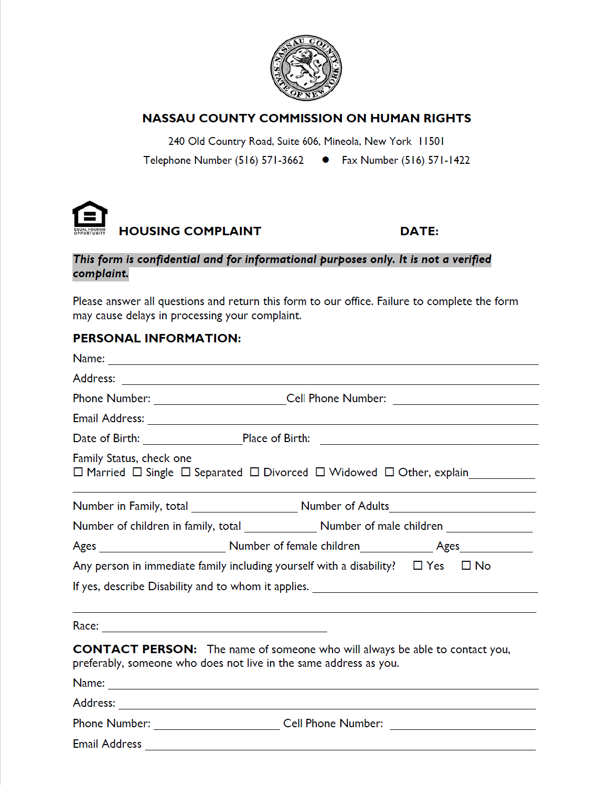
NCHRC Housing Complaint Process
Anyone can file a complaint with Nassau County Commission on Human Rights, free of charge.
We only accept complaints if the property is in Nassau County.

Slide 33
Housing Complaint Process
Upon receiving a case, it is entered into our system.
The case is then assigned a number and an investigator.
Within two weeks, we reach out to the complainant. We ask questions to gather information in order to draft a complaint.
Once a complaint is drafted, it is submitted to the Executive Director for corrections and/or dialogue.
Intake

Slide 34
Housing Complaint Process
We send complainant a Mail-Out letter confirming the formal complaint has been filed.
Complainant is also sent a copy of the formal complaint.

Slide 35
To Respondent:
Respondent is sent a cover letter informing them that a Fair Housing complaint has been filed against them. In this packet, we send them a Request of Information form, Respondent contact sheet, and a copy of the complaint.
We request a response within 15 days. This goes out via Certified mail.
Normally, respondent or respondent's attorney will reach out to us requesting an extension of time to submit a response to the allegations. Up to 30 days are granted. If a response is not received within the 30 days, all allegations are deemed admitted.
If respondent fails to respond to the complaint, by day 45 we will mail out a Failure to Respond letter. This will go out via regular and Certified Mail. Copies of the complaint go out along with original packet that was sent out previously.

Slide 36
Investigation Process
A response is received on or around 30 to 45 days after the formal complaint has been filed. Once the Commission receives the response, we mail it out to the complainant requesting a rebuttal. Complainant is given 15 days to submit if they choose to do so.
We conduct telephone calls and schedule a two-party fact-finding conference. During the conference, we gather documents, information, and interview witnesses.
After the conference, we give all parties 2 weeks to submit closing arguments if they choose to do so.
While we wait for the closing arguments, we type up a summary of the two-party conference.
After receiving the closing arguments, we type up a Findings Report and it is submitted along with the summary to the Supervisor.

Slide 37
Conciliation
Most times with housing cases, we can conciliate.
Respondent’s attorney is asked to draft a Stipulation of Settlement.
Complainant has also signed a withdrawal letter.
The Commission will keep copies of all documents in file and the case will be closed.

Slide 38
No Probable Cause Determination
If after a complete and thorough investigation, the Commission finds NO PROBABLE CAUSE, it means that no clear evidence was submitted to determine that the complainant was discriminated against or a housing discrimination occurred.
The case will then be closed.
All determinations are mailed to the parties with an Affidavit of Service.
If complainant does not agree with the determination, they can appeal the case by sending an appeal letter addressed to the Commissioners.
This letter should be sent to the Commissions office.

Slide 39
Probable Cause Determination
If After a complete and thorough investigation, the Commission finds PROBABLE CAUSE, the case is submitted to the Commissioners for review.
The case then goes to the County Attorney’s Office to conduct a hearing by an Acting Law judge.
All determinations are mailed to the parties with an Affidavit of Service.

Slide 40
Complaint Filing Time Limit
A housing discrimination complaint must be filed with HUD within one year of the housing discrimination occurrence.
You have two years to file a Federal District Court complaint if you do not wish to file through an agency.
If the discriminatory act occurred on or after February 15, 2024, you have three years to file a complaint with the New York State Division of Human Rights.
If you are able to prove that you have been a victim of housing/lending discrimination, the FHA may entitle you to receive compensation for actual damages, including humiliation, pain and suffering, and other relief. In some cases, the law may also allow punitive damages.

Slide 41
Community Outreach and Participation

Slide 42
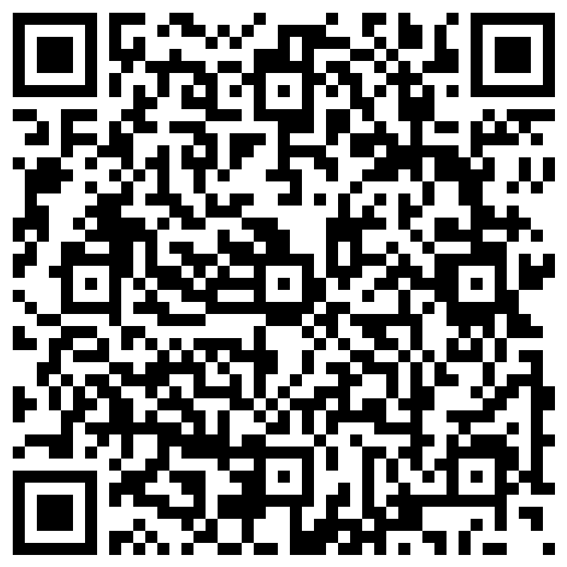
Community Outreach/Participation
YOU can participate
The Nassau County Fair Housing Survey is LIVE through April 18th, 2025
Available in English and Spanish
Take the Survey NOW!
https://forms.office.com/r/bLck4J5Dea

Slide 43
Community Outreach/Participation
YOU can participate
Review and comment on:
Draft Analysis of Impediments to Fair Housing Choice
Expected to be issued on May 5, 2025
Followed by a 30-day comment period

Slide 44
Community Outreach/Participation
YOU can participate
Attend Public Hearing #2:
Presentation of Consolidated Plan, Annual-Action Plan, and Analysis of Impediments
May 13, 2025 – 6:00 PM

Slide 45
Public Comments
Written comments can be submitted by June 4, 2025
Written Comments can be sent to:
Jeffrey Clark, Executive Director Jclark@nassaucountyny.gov | Donald Crosley, Deputy Director Dcrosley@nassaucountyny.gov
Nassau County Office of Community Development 1 West Street – Suite 365 Mineola, NY 11501

Slide 46
Questions
Questions on Fair Housing Issues can be sent to:
Nassau County Human Rights Commission Rodney H. McRae Executive Director rmcrae@nassaucountyny.gov Long Island Housing Services Ian Wilder, Esq. Executive Director Ian@lifairhousing.org

